Slide 1
Note for the honourable teachers:
This slide is hidden.
Please start with F5 to keep it hide.
The subject teachers are requested to read the notes given below the slides.
Notes are given bellow the slide no. 2, 4 and 12.

Slide 2
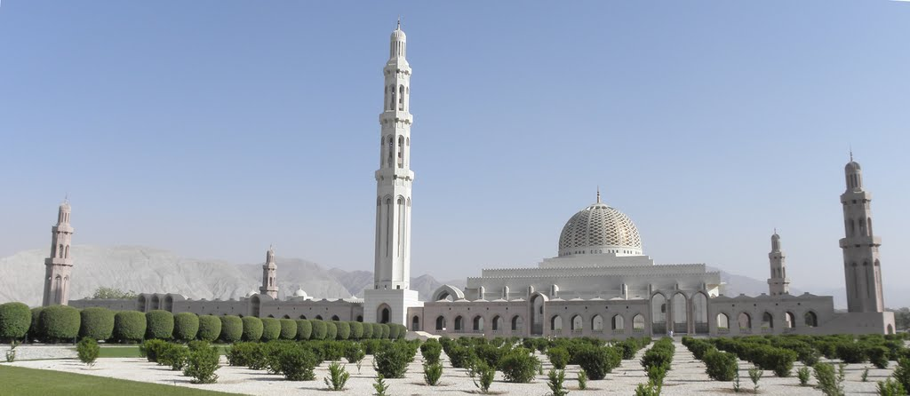
W
E
L
C
O
M
E
Notes:
Masjid Sultan Qaboos in Oman.

Slide 3
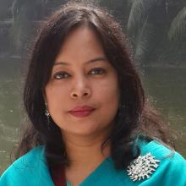
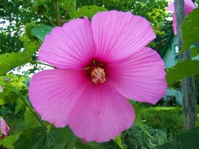
INTRODUCTION
ROUFUN NAHAR
ASSISTANT TEACHER ( ENGLISH)
MAZIDA GOVT. HIGH SCHOOL,
TONGI, GAZIPUR
CLASS: NINE-TEN
SUBJECT: ENGLISH 1ST PAPER

Slide 4
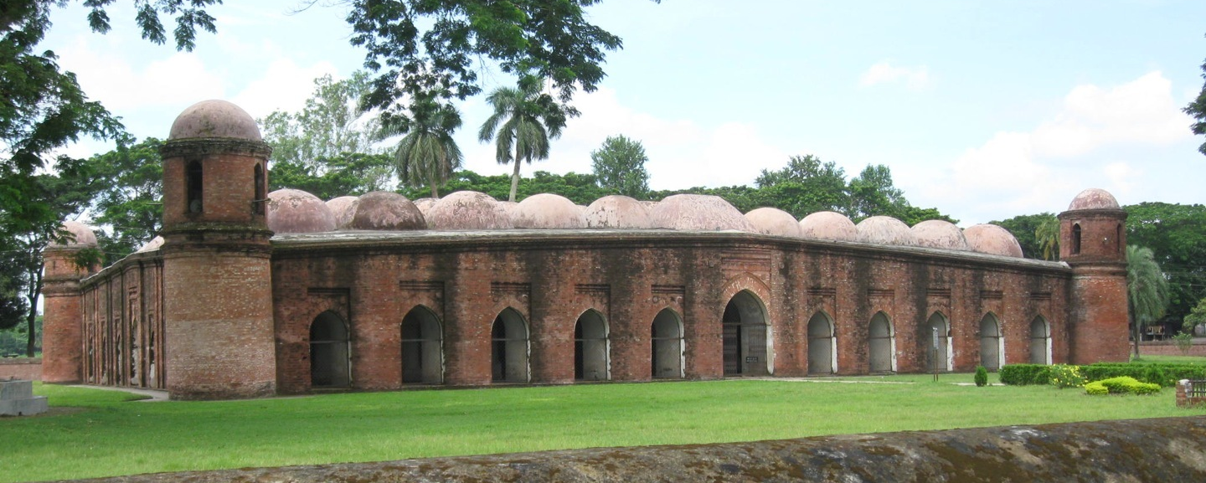
What do you see in the picture? Describe it.
This is the Shat Gombuj Mosque. It is one of the historical places of Bangladesh. It is also one of the world heritages.
Notes:
The teacher can ask the question to the students first. The students may be able to answer or may not. If any student can answer, the teacher can ask few other question related to the picture. Then the teacher can show the information given below the picture.

Slide 5
Today our topic is
The Shat Gambuj Mosque
Unit- 8
Lesson- 1

Slide 6
Learning Outcomes Of The Lesson
After this lesson the students will be able to-
1. talk about a picture.
2. listen for specific information.
3. read and understand the text through silent reading.
4. write about a place.
5. infer the meaning from the text.

Slide 7




First read the questions then listen to the audio about the Shat Gombuj Mosque and choose the best answer.
1. How many world heritage sites are there in Bangladesh?
a) one b) two c) three d) four
$$$$
2. Where is the Shat Gombuj Mosque situated in?
a) centre of Bagerhat b) out of Bagerhat
c) suburb of Bagerhat d) centre of Khulna
$$$$
3. Which have worn away with the passage of time?
a) pillars b) domes c) doors d) roof
$$$$
4. When Khan Jahan Ali established this mosque?
a) before 1405 b) after 1405
c) before 1459 d) after 1500
$$$$

Slide 8
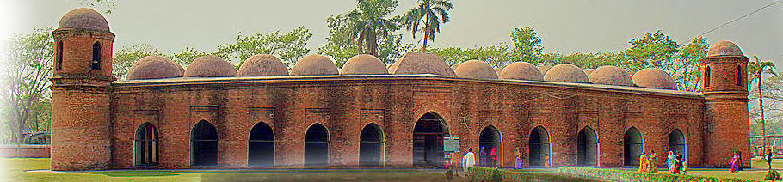
Have a look outside the mosque.
Four corners have 4 smaller dooms
77 low height dooms
11 Arched doorways on east

Slide 9
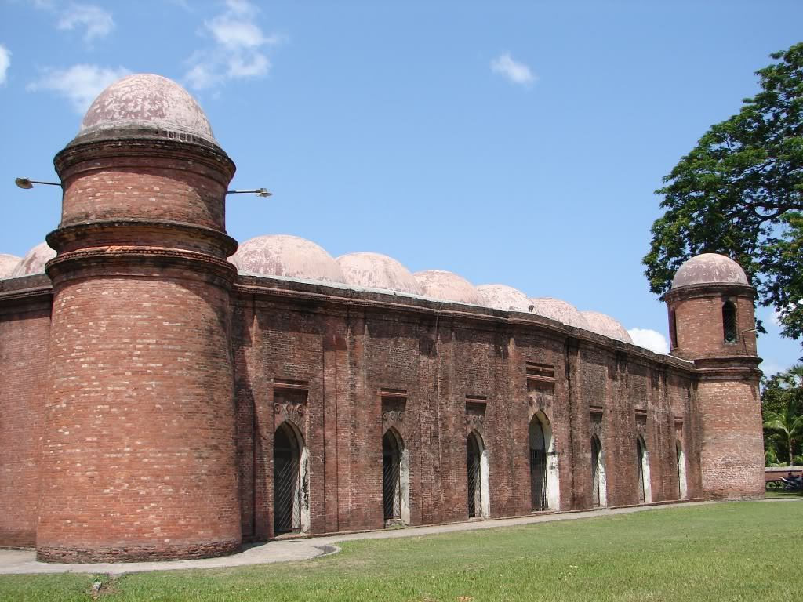
7 Arched doorways each on north and south

Slide 10
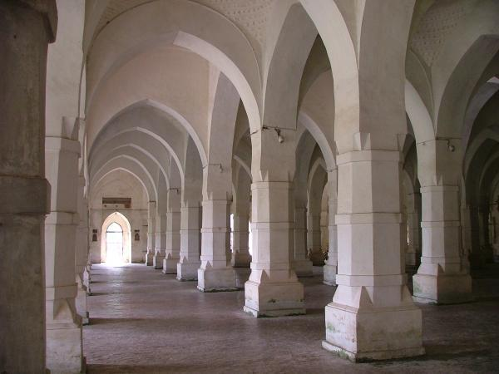
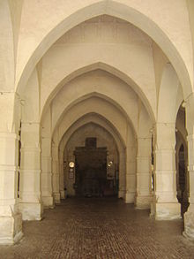
What do you see inside the mosque?

Slide 11
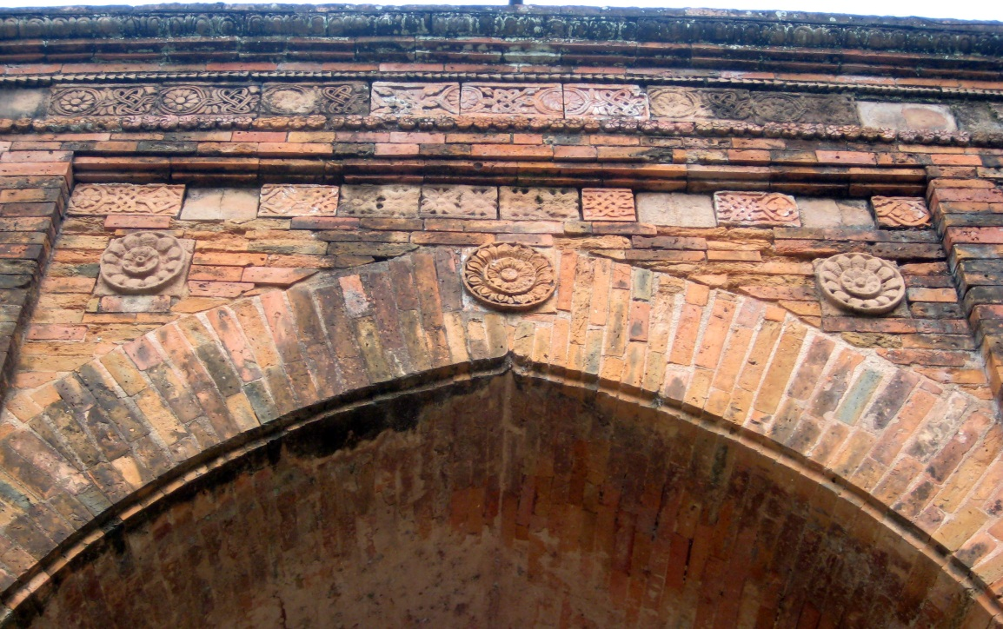
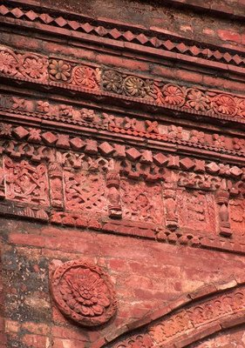
The interior western wall of the mosque is beautifully decorated with terracotta .

Slide 12
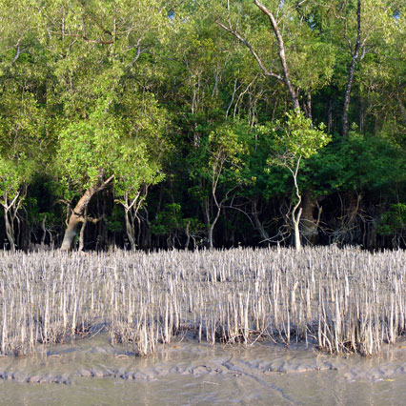
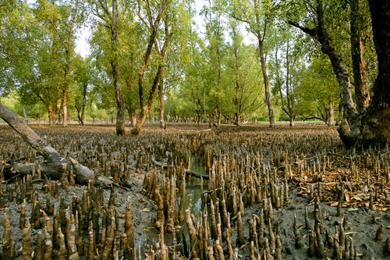
Mangrove
New Words
A tree or shrub that grows in wet mud at the edge of river
Meaning
Sundarban is a mangrove forest.
Notes:
First, the word will be shown. The SS will be asked to pronounce the word. If it is needed teacher can help. Then the picture and the sentence will be shown and asked to guess the meaning. After that the meaning will be shown. Then the teacher can ask the students to make a sentence of their own. In the same way, slide no. 8-12 can be conducted.

Slide 13
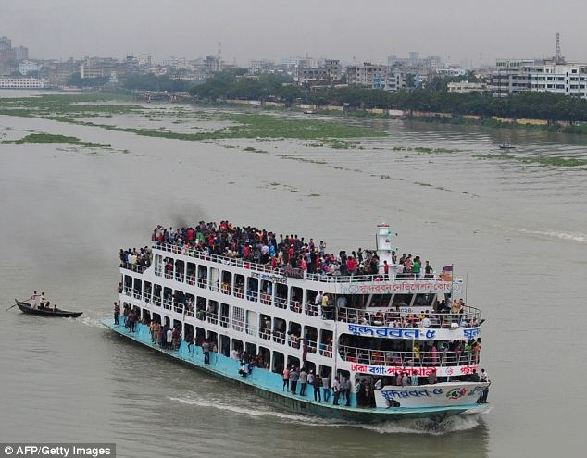
Outskirts
The outer parts of a town or city.
Meaning
The Buriganga river is at the outskirts of Dhaka city.

Slide 14
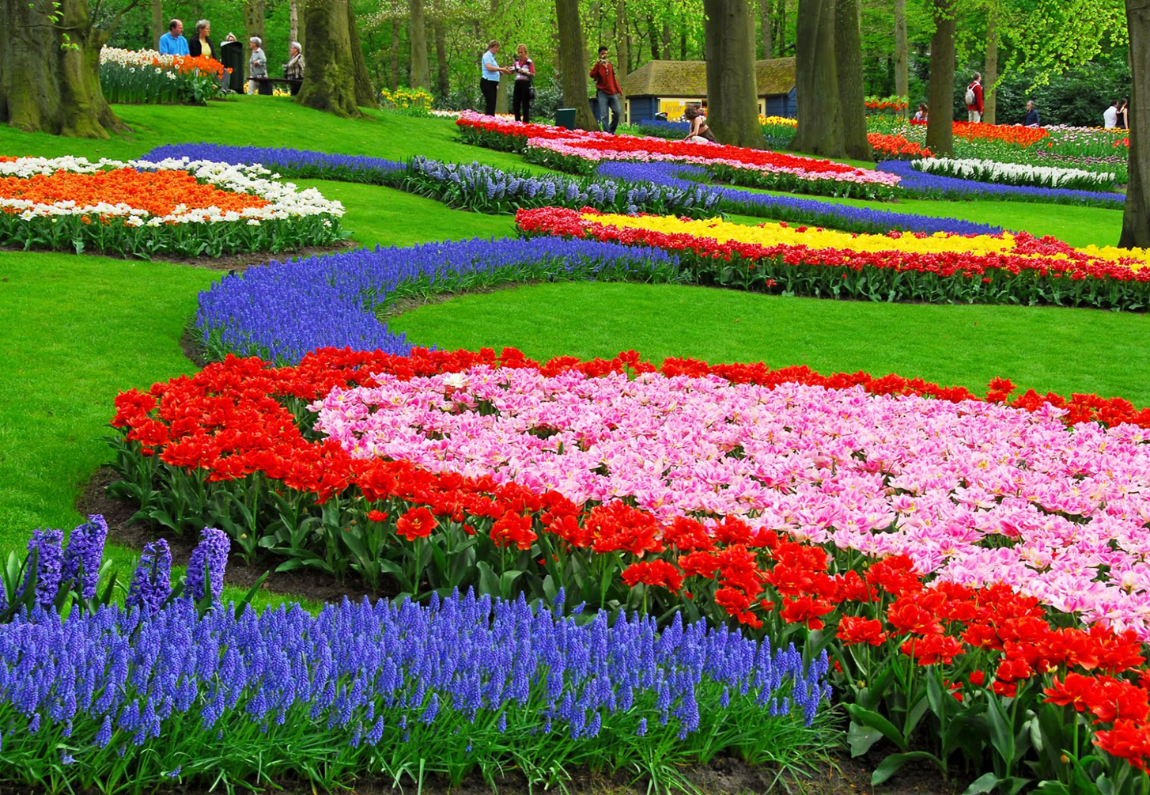
Remarkable
Meaning
Worthy of attention
The garden is very remarkable for its various colourful flowers.

Slide 15
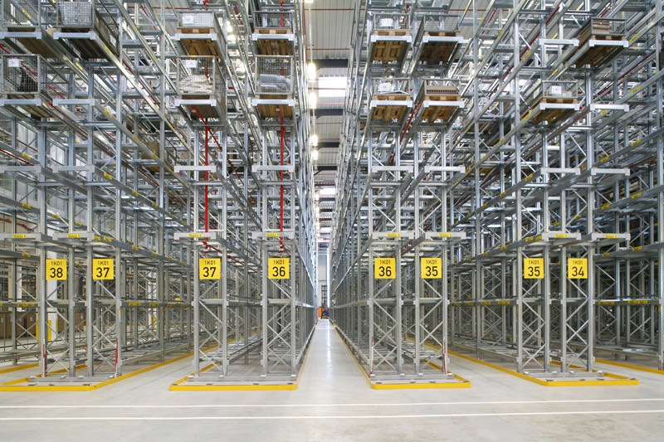
Aisle
Meaning
Path/ corridor
We can see five aisles in the picture.

Slide 16
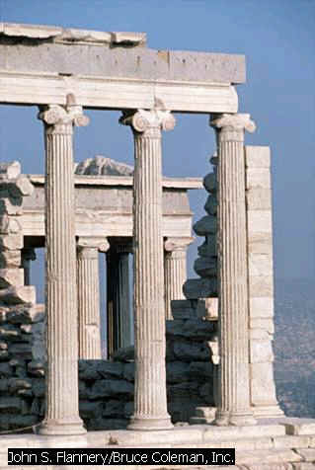
Slender
Column
Thin
A tall pillar made of stone
Few slender columns of the destroyed building are still standing.

Slide 17
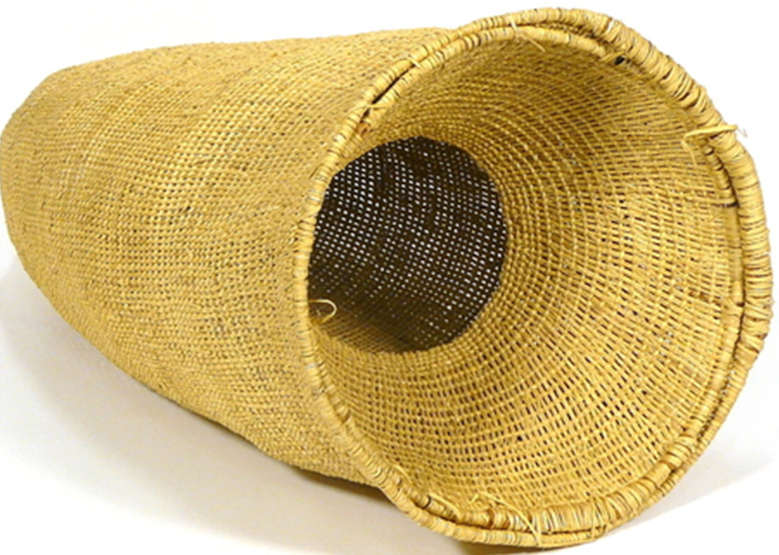
Hollow
Meaning
Empty space inside
Hollow
There is a hollow in the basket.

Slide 18
Read the text in the book and write the answers of the following questions.
Q 1. Why is the Shat Gombuj Mosque a world heritage?
Q 2. How are the decorations of the mosque?
Q 3. Why were there many doorways in the mosque?
Q 4. For what purpose was the mosque used?

Slide 19
Read the text again and fill the table . [pair work]
Who/What | Event/Activities | When/Why
The Shat Gombuj Mosque | a) …………….. | in 1985
It | was founded | b) ………………
Khan Jahan Ali | c) ……………... | to fit the city to live in.
The mosque | is unique | d) ….………….
It | e) ……………… | for its architectural beauties.
a) became a UNESCO World Heritage Site
b) in the 15th century.
c) built a networks of roads, bridges, public buildings and reservoirs
d) for its 60 pillars that supports the roof with 77 low height domes.
e) attracts the tourists

Slide 20
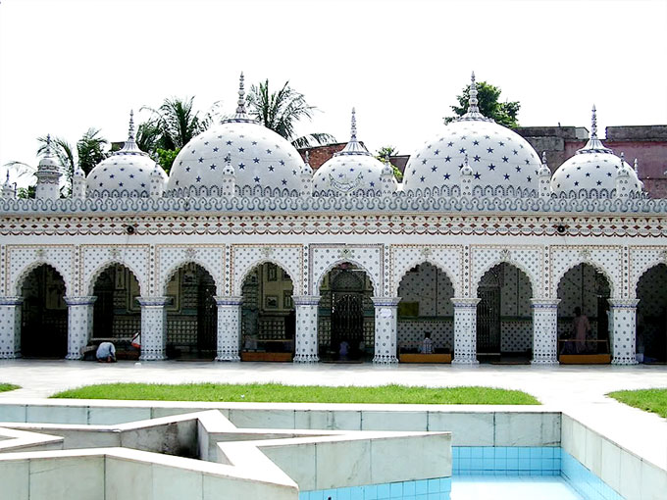
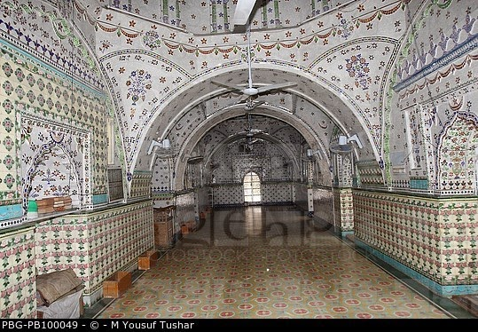
Group work
Look at the picture of the Star Mosque in Dhaka. Write a description on the Star Mosque with the help of the given clues. ( See the clues in the text book).

Slide 21
Homework
Do your area has such building like the Shat Gombuj Mosque or the Star Mosque? Write about that building. (Not more than 15 lines)

Slide 22
Acknowledgement
MoE, DSHE, NCTB & A2I respective of officials
And the editors panel: Ranjit Poddar, Associate Professor (English) TTC, Dhaka, Md. Jahangir Hasan (English), Assistant Professor TTC, Rangpur and Urmila Khaled Assistant Professor (English) TTC, Dhaka.
Their direction, valuable suggestions and intensive supervision have enriched the model contents.

Slide 23

Thank You All

